Slide 1
RUOLO DELLA TERAPIA MEDICA
LUCA BUSETTO
Università di PADOVA

Slide 2



Luca Busetto
Dipartimento di Medicina – DIMED
Università degli Studi di Padova
Centro per lo Studio ed il Trattamento Integrato dell’Obesità
Azienda Ospedaliera di Padova
Direttore Scuola di Specializzazione in Scienza dell’Alimentazione
Università degli Studi di Padova
Vice Presidente della European Association for the Study of Obesity (EASO)
Past President della Società Italiana dell’Obesità (SIO)

Slide 3

Luca Busetto
Disclosures: - Advisory Board Member: Novonordisk
Bruno Farmaceutici Pzifer
Eli Lilly
Boehringer Ingelheim
- Speaker: Rythm Pharmaceuticals
  Pronokal

Slide 4
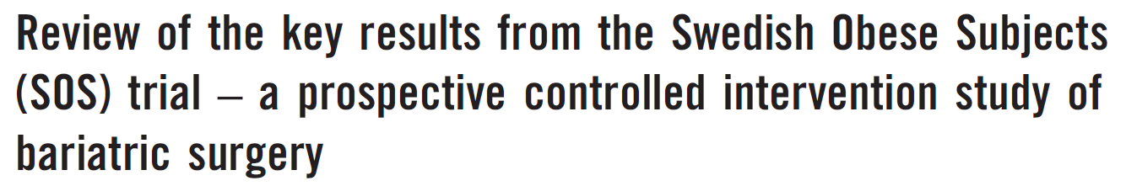
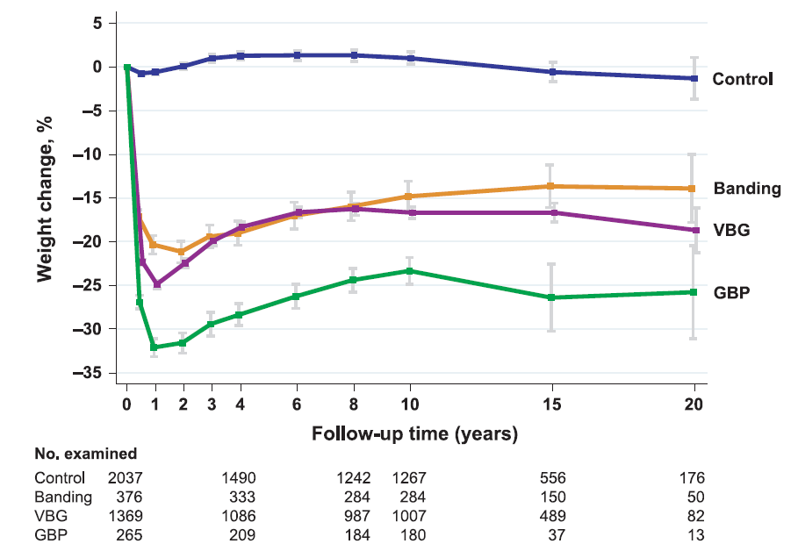
Sjöström L. J Int Med 2013;273:219

Slide 5

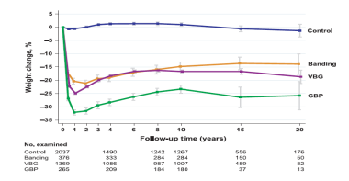
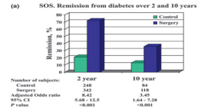
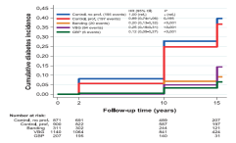
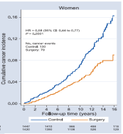
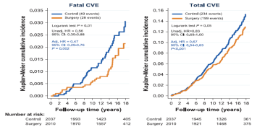
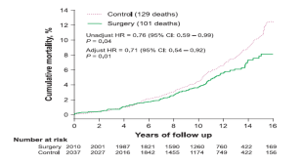
Sjöström L. J Intern Med 2013;273:219

Slide 6



Obesity management is changing
Invasivity/Risk/Cost
10
20
30
%WL

Slide 7
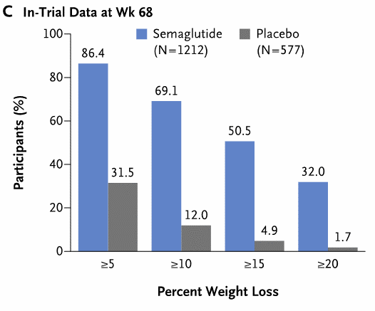
Wilding JPH et al. NEJM 2021;384:989

Slide 8
Garevy WT et al. Nat Med 2022;28:2083

Slide 9
Jastreboff AM et al. N Engl J Med 2022;387:205

Slide 10
Jastreboff AM et al. N Engl J Med 2023; june 26

Slide 11
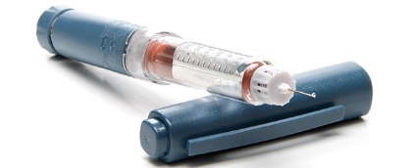
Invasivity/Risk/Cost
10
20
30
%WL

Slide 12

Will new pharmacological treatment for obesity and early diabetes replace bariatric surgery?
Lingway I et al. Lancet Diabetes Endocrinol 2023;11:541

Slide 13
A significant proportion of patients do will not achieve the target with obesity management medications
Jastreboff AM et al. N Engl J Med 2022;387:205

Slide 14
A significant proportion of patients do will not achieve the target with bariatric/metabolic surgery
Peterli R et al. JAMA 2018;319:255

Slide 15
RYGB or LSG patients with persistent or recurrent type 2 diabetes
at least 1 year after surgery from five hospitals in London, UK.
Miras AD et al. Lancet Diabetes Endocrinol 2019;7:549

Slide 16
Inclusion criteria:
Poor weight loss after MS (RYGB or LSG)
≤ 20% body weight loss at least 1 year after MS
Suboptimal nutrient-stimulated GLP-1 response
≤ 2-fold increase in circulation GLP-1 between 0 and 30
min following a standardised 500 kcal mixed liquid meal
Mok J et al. JAMA Surg 2023;158:1003

Slide 17
Mok J et al. JAMA Surg 2023;158:1003

Slide 18

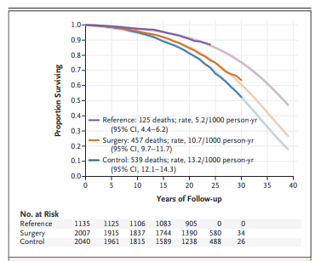
Carlsson LMS et al N Engl J Med 2020;383:1535

Slide 19

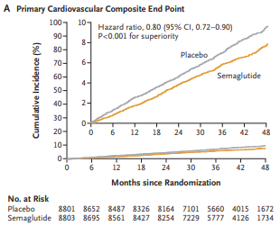
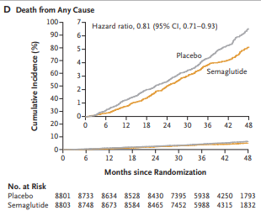
Lincoff AM et al N Engl J Med 2023;389:2221

Slide 20


TREATING OBESITY TO TARGET

Slide 21
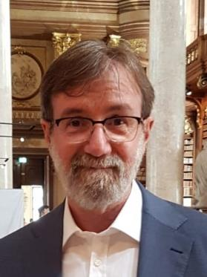



Grazie !!!
Grazie !!!
luca.busetto@unipd.it
Luca Busetto
@busetto_luca

Slide 22

Grazie !!!

